Slide 1
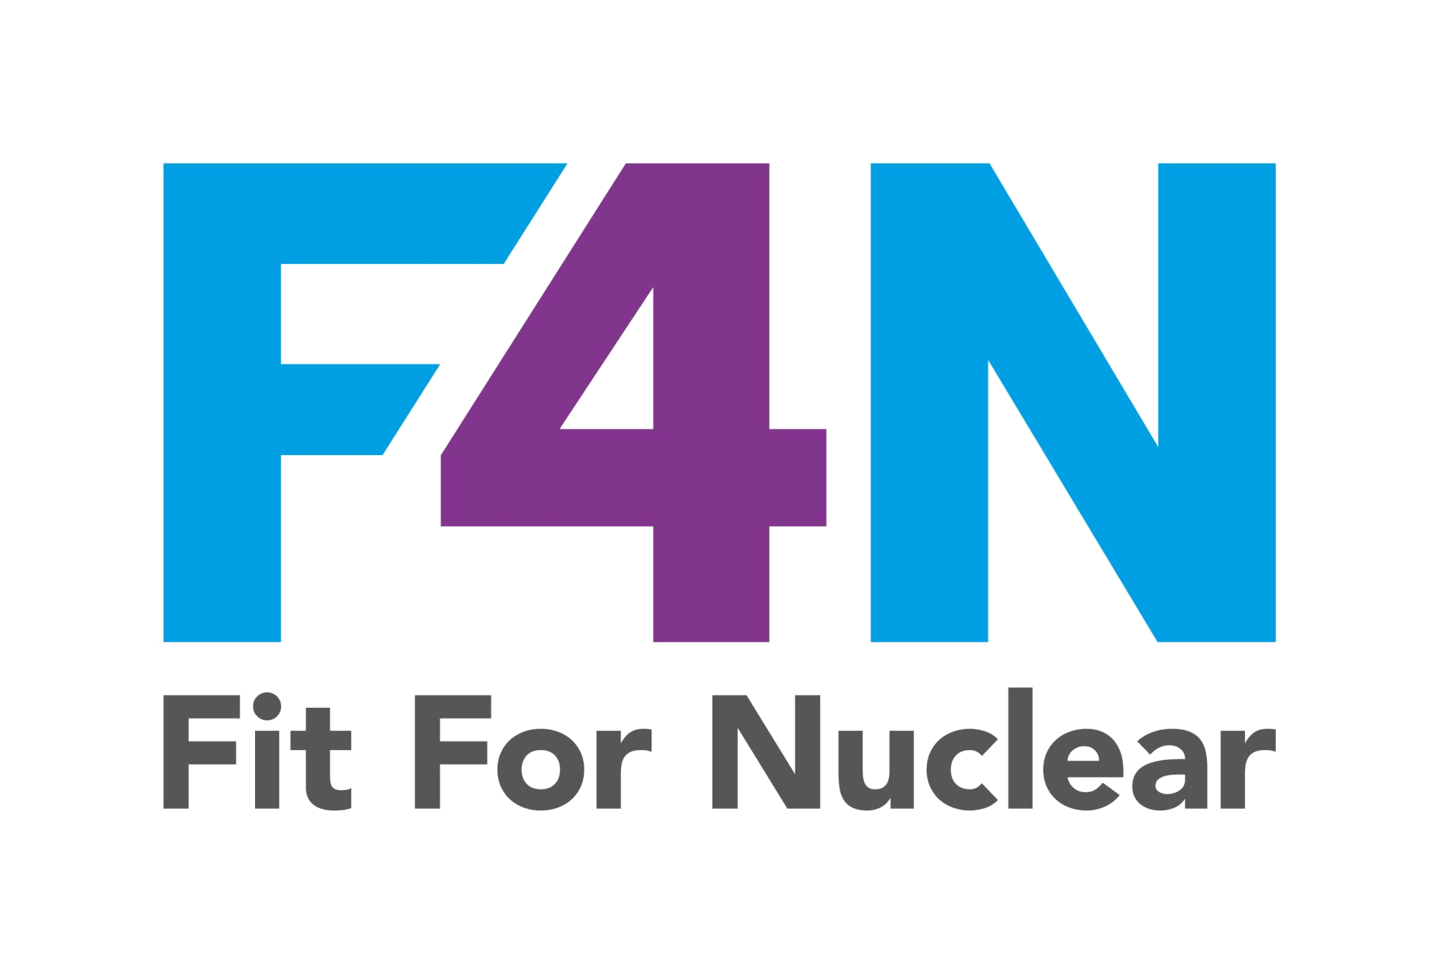

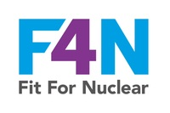
Nuclear Sector Awareness
Understanding What Makes Nuclear Different
NucCol | Nuclear Collaboration Ltd · Fit For Nuclear Programme · Commercial in Confidence | 1

Slide 2

What We Will Cover Today
Section 1: The UK Nuclear Sector and the Opportunity
Section 2: The Regulatory Framework
Section 3: Core Nuclear Safety Principles
Section 4: Nuclear Risks You Need to Know About
Section 5: What is Expected of Our Business
Section 6: Your Personal Responsibilities
This session will take approximately 45-60 minutes. Please ask questions as we go.
NSS-01d | of
NucCol | Nuclear Collaboration Ltd · Fit For Nuclear Programme · Commercial in Confidence | 2

Slide 3
01
The UK Nuclear Sector
NucCol | Nuclear Collaboration Ltd · Fit For Nuclear Programme · Commercial in Confidence | 3

Slide 4
Why Nuclear Matters to Our Business
The Scale of the Sector
What Makes Nuclear Different
New build: Hinkley Point C and Sizewell C represent billions of pounds of supply chain opportunity
Decommissioning: the Nuclear Decommissioning Authority manages clean-up across 18 sites
SMR programmes: smaller factory-built reactors creating new manufacturing demand from the early 2030s
Existing fleet: sustained maintenance and life extension work at operating stations
Safety is the overriding priority in every decision, always
Quality requirements are more rigorous and more thoroughly verified than any other sector
Documentation must be traceable for decades, not just the life of a contract
Cultural standards around reporting and accountability are actively assessed by clients
The consequences of getting it wrong can affect people and the environment for generations
NSS-01d | of
NucCol | Nuclear Collaboration Ltd · Fit For Nuclear Programme · Commercial in Confidence | 4

Slide 5
The Standard We Are Working To
Working in nuclear is not like working in any other sector. The consequences of errors can be severe, long-lasting, and impossible to reverse.
This is not about adding bureaucracy. It is about recognising that what we make and do becomes part of infrastructure that must work reliably for decades. The standards exist because they need to.
NSS-01d | of
NucCol | Nuclear Collaboration Ltd · Fit For Nuclear Programme · Commercial in Confidence | 5

Slide 6
02
The Regulatory Framework
NucCol | Nuclear Collaboration Ltd · Fit For Nuclear Programme · Commercial in Confidence | 6

Slide 7
Who Regulates Nuclear in the UK
ONR
EA
NDA
HSE
Office for Nuclear Regulation
Environment Agency
Nuclear Decommissioning Authority
Health & Safety Executive
Primary nuclear safety regulator. Enforces licence conditions and can inspect supply chains.
Regulates environmental discharges and radioactive waste. Equivalent bodies in Scotland and Wales.
Responsible for clean-up of legacy nuclear sites. Also a major client for supply chain work.
Conventional health and safety on nuclear sites. H&S at Work Act applies to all.
As a supplier you comply with requirements your client flows down from their licence conditions. You are not licensed yourself but the regulatory framework governs everything your client asks of you.
NSS-01d | of
NucCol | Nuclear Collaboration Ltd · Fit For Nuclear Programme · Commercial in Confidence | 7

Slide 8
03
Core Nuclear Safety Principles
NucCol | Nuclear Collaboration Ltd · Fit For Nuclear Programme · Commercial in Confidence | 8

Slide 9



The Three Principles You Must Know
Defence in Depth
ALARP
The Safety Case
Safety never relies on a single person, system, or control. Multiple independent layers of protection are built in at every stage.
Your quality checks, your documentation, your people, your NCR process are all layers. Each must work reliably.
Risks must be reduced As Low As Reasonably Practicable. This means you must act on risks, not accept them as normal.
Cost and schedule never override the requirement to reduce risk. Decisions to accept risk must be documented and justified.
The nuclear operator maintains a formal argument supported by evidence that their facility is acceptably safe.
Your quality records, certificates, and test results are evidence that supports this case. They may be called upon 30 years from now.
NSS-01d | of
NucCol | Nuclear Collaboration Ltd · Fit For Nuclear Programme · Commercial in Confidence | 9

Slide 10
04
Nuclear Risks
NucCol | Nuclear Collaboration Ltd · Fit For Nuclear Programme · Commercial in Confidence | 10

Slide 11

Types of Nuclear Risk
Radiological risk: exposure to ionising radiation on or near active facilities. Most off-site manufacturers have limited direct exposure, but the products they make will operate in these environments.
Operational risk: unplanned shutdowns, loss of cooling, loss of containment. A component failure is not just a quality issue - it can trigger a regulatory notification.
Environmental risk: radioactive contamination of land, water, and air. Strict permit conditions apply to all work on licensed sites.
Reputational and programme risk: quality failures are visible and have long-lasting consequences. A poor record can close doors across the nuclear sector permanently.
Graded quality means the level of control is matched to the consequence of failure. Even lower classification work must meet your quality management system requirements.
NSS-01d | of
NucCol | Nuclear Collaboration Ltd · Fit For Nuclear Programme · Commercial in Confidence | 11

Slide 12
05
What Is Expected of Us
NucCol | Nuclear Collaboration Ltd · Fit For Nuclear Programme · Commercial in Confidence | 12

Slide 13
What Our Nuclear Clients Expect
Systems and Processes
People and Culture
A formal quality management system meeting ISO 9001 as a minimum, with ISO 19443 as the nuclear target standard
Full traceability of every material, component, and service from order placement to delivery
Documented, formal non-conformance management with root cause analysis
CFSI controls: processes to prevent counterfeit and suspect items entering the supply chain
Staff competent for the work they perform, with training records to demonstrate it
Safety is visibly the overriding priority at all levels of leadership
People feel able to raise concerns without fear of blame or consequence
Near misses and problems are reported and used to improve, not hidden
Everyone understands their role in maintaining nuclear standards
NSS-01d | of
NucCol | Nuclear Collaboration Ltd · Fit For Nuclear Programme · Commercial in Confidence | 13

Slide 14



Your Responsibilities
Follow the procedures and work instructions for your role. Do not shortcut them.
Raise concerns immediately. If something does not look right, stop and report.
Never approve, sign off, or release work you are not fully satisfied with.
Maintain accurate, complete records. They matter more than you might think.
Ask questions if you are unsure. Assumptions have no place in nuclear work.
The standard you walk past is the standard you accept.
NSS-01d | of
NucCol | Nuclear Collaboration Ltd · Fit For Nuclear Programme · Commercial in Confidence | 14

